Slide 1

Blockchain-as-a-Service on Microsoft Azure
Or How to build your own CryptoCoin
Friday, 23rd of February 2018

Slide 2
Introduction
Brought to you by the Cambridge MSPs
Short introduction to Blockchain
Hands on practical afterwards
Build your own Ethereum-based Crypto Coin

Slide 3
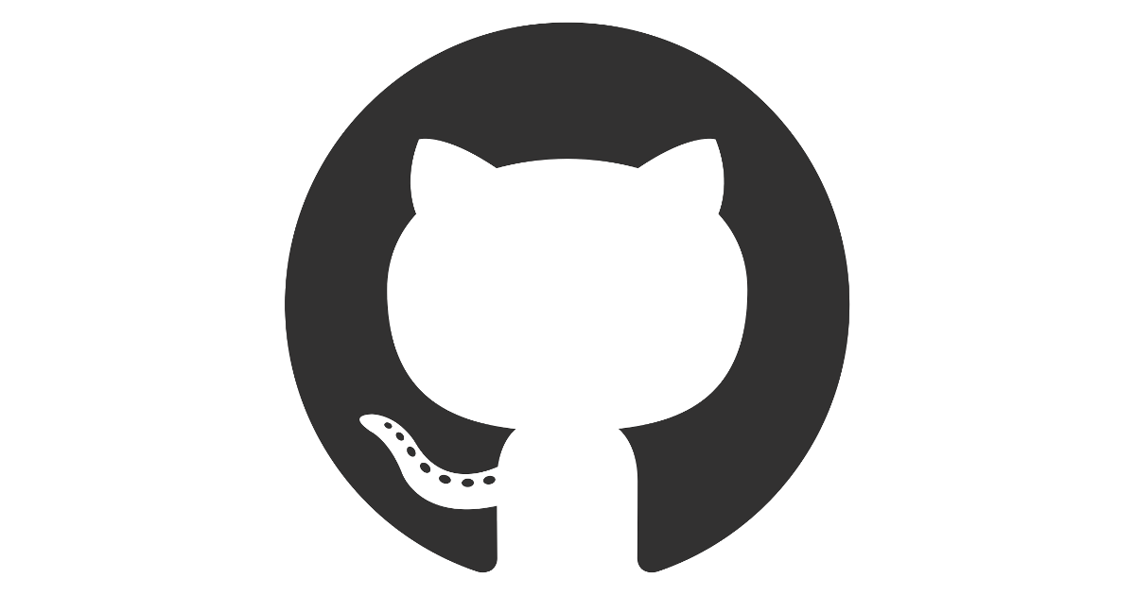
Github
https://github.com/cambridge-msp
Instructions
Resources
Presentation
Notes:
On the github repository you can find all the relevant information for finishing the project on your own or replicating it later.

Slide 4
Setting up stuff
The following resources are required to successfully finish the workshop:
Install npm: https://nodejs.org
Install Putty (Windows only): https://www.chiark.greenend.org.uk/~sgtatham/putty/latest.html
Install MetaMask browser addon

Slide 5
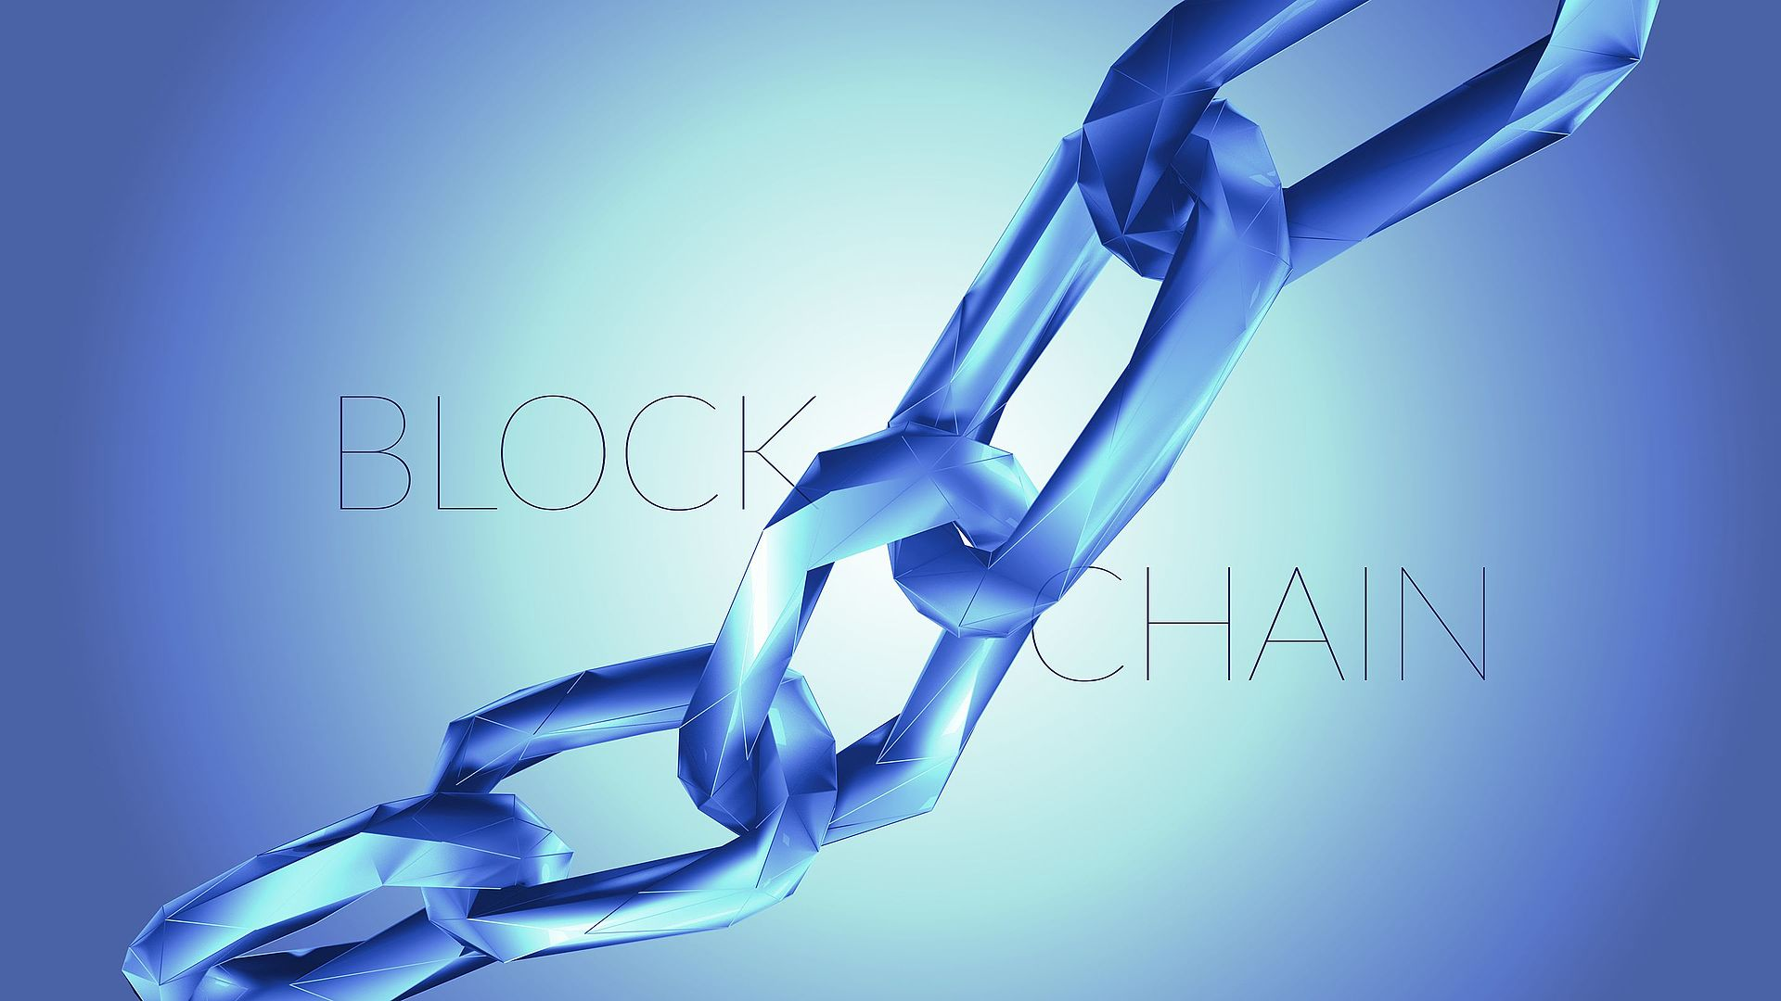
What is a Blockchain?
Distributed databases
Made up of blocks
Offers secure* storage of transaction data
Bitcoin, Ethereum etc.
*tamper-resistant, secure, verifiable
Notes:
Blockchains are essentially a distributed database wherein each block is linked to another block in the chain by way of hashes from another block. This means that a block cannot be modified without breaking the entire chain. Having these interlinking blocks makes the chain forward moving only – data cannot be retroactively changed once it is written to a block. With this limitation, the tradeoff means that the chain is tamper resistant because changing data would change hashes, secure in that the data is immutable, and verifiable in that the hashes can be reproduced from the data. Blockchain was invented for Bitcoin, but its uses go far beyond cryptocurrency. For an interesting read on how Blockchain might be used to implement secure electronic voting, see https://venturebeat.com/2016/10/22/blockchain-tech-could-fight-voter-fraud-and-these-countries-are-testing-it/.

Slide 6
How Do Blockchains Work?
No trusted third-party authority
Decentralized network of nodes
Connected via the internet
Block validation via network
Majority agreement validation
Creates an immutable ledger.
Traditional Trusted Third-Party Authority
Blockchain as an Immutable Ledger
Notes:
Unlike other systems of trust, such as public key infrastructure that rely on a trusted third party such as a certificate authority, block chains operate on a peer-to-peer basis. The trust inherent to blockchains, as described, rests on the fact that the data in the blocks is used to create the hashes for new blocks. The means that blockchains have no central authority or the like overseeing the block chain. Likewise, blockchains become more secure with size and redundancy as data on chains is copied between nodes on the peer-to-peer network.

Slide 7

Blockchain Mining
Nodes discovered by “mining”
Achieved by running resource intensive algorithms
Node who succeeds in finding and validating the solution receives “coin” as reward
Complexity relative to number of miners / network size
Notes:
Blockchain “mining” is the process of discovering new blocks to be used on the chain. When a blockchain is new, discovering new blocks happens quickly. However, as the blockchain grows, the rate slows down substantially because the complexity of the chain grows exponentially.
Miners will setup mining nodes whose sole purpose is to discover new blocks to receive Bitcoins. Some clever setups have used arrays of GPU’s to create massive parallel computing platforms.
Blockchain miners are rewarded with “coin” (a.k.a. “cryptocurrency”), which is a digital currency that can be used on the blockchain. Many different types of coin exist with the most popular being Bitcoin. The valuation of these currencies in traded currencies is in the billions of dollars as of 2017.

Slide 8

Wallets
Users must set up virtual bank account – called “wallets”
Stores personal coins associated to the user
Acts as client on the blockchain network
Has ability to send / receive money
MetaMask, Electrum, Armory …
Notes:
In order to use blockchain, a user has to setup a virtual wallet to track his or her coin. The wallet is usually some kind of app that can interact with a blockchain network to send and receive coin from one address to another address on the network. The address is a unique identifier on the network to which coin is tied. Anyone can setup an address without coin in it and do so anonymously.
The peer-to-peer nature of blockchain networks and the anonymity of the transaction is one of the big selling points of cryptocurrencies. Likewise, this scheme has the potential to drastically cut down on the security and administration of centrally managed currencies. There’s no private key infrastructure, no need for credit card security, no need for central banks, and so on.

Slide 9
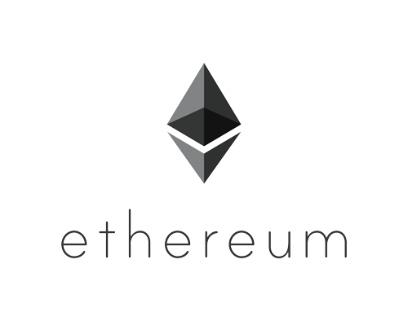
Ethereum
blockchain network
open-source technology
Not pure cryptocurrency
invented as general-purpose blockchain
can be applied in new and creative ways.
https://www.ethereum.org/
Notes:
Ethereum is both a blockchain network and a technology. The Ethereum networks employees the technology, but one does not have to subscribe to the Ethereum network in order to use the Ethereum technology. It allows users to create their own blockchains for whatever reason he or she sees fit, and that blockchain can be publicly shared or privately shared depending on how it is applied.
Ethereum is a general purpose blockchain that still has all the concepts of those designed for cryptocurrencies. Ethereum nodes mine “Ether” as the currency that is exchanged in Ethereum networks.

Slide 10
Uses for Ethereum
Because Ethereum is general-purpose, it can be used for all sorts of applications in which a secure network of trust is needed. Some possibilities include:
Bond trading
Secure electronic voting
Identity management
Real-estate transactions
Electronic banking
Supply-chain management
Notes:
Ethereum is finding uses all over the place. Many experts consider blockchains to be a disruptive technology because it changes the way that people use technology for business. The peer-to-peer nature of the technology decentralizes control and reduce administrative overhead in many ways for maintaining data integrity.

Slide 11

Smart Contracts
Small programs that run on a blockchain network
called via RPC.
When an app changes data on the blockchain, it costs a transaction free
Contracts are typically written in a language called Solidity.
Notes:
Smart contracts are the how Ethereum makes its blockchain implementation more general purpose. A contract is really nothing more than a program that runs on the blockchain. The program can be called through the Remote Procedure Call (RPC) protocol built into Ethereum and parameters can be passed to the RPC just like they can on other RPC technologies. Likewise, data can be read and stored using the RPC.
RPC’s that write to a block chain though in a smart contract are called transactions. Writing to the blockchain requires Ether be paid to run the RPC. RPC’s that read data from the blockchain do not require Ether.

Slide 12
Blockchain Weaknesses
subject of much debate since exploited in 2016.
Smart contracts are like any other software, only as good as the developers who write them.
Contracts are public to the network, so if a contract has a bug, anyone can exploit it.
Notes:
Smart contracts, being custom code, open up the possibility for bugs to be introduced into a system. Like all software, the bugs can expose data or even worse allow hackers to siphon off resources as was done in 2016 when hackers exploited the Ethereum network. Several million dollars worth of ETH was stolen as a result before the software could be patched.
The guiding principle for Smart Contracts is to keep them simple as possible. This mitigates the risk of introducing bugs dues to complexity. Likewise, like all software, it is good to a QA process in place to test contracts. Because Ethereum can be deployed as a stand-alone system, Ethereum contracts can be tested before they are put into a production Ethereum network.

Slide 13
Solidity
programming language for writing smart contracts
syntactically similar to JavaScript.
Contracts are declared in Solidity, with each method being a Remote Procedure Call on that contract.
pragma solidity ^0.4.0;
contract SimpleStorage {
uint storedData;
function set(uint x) {
storedData = x;
}
function get() constant returns (uint) {
return storedData;
}
}
https://solidity.readthedocs.io/en/develop/
Notes:
Solidity is a common programming language used to write Smart Contracts on Ethereum. Solidity is syntactically similar to JavaScript, so most any developer with JavaScript experience can quickly pickup and use Solidity.
Solidity is compiled using the solc compiler. The compiler doesn’t actually produce a binary, rather it produces a JSON file that contains a description of the API exposed by the contract as well as serialized form of the byte code.

Slide 14
Deploying Contracts
Ethereum uses transaction nodes to run contracts
JSON file produced by the contract compiler deployed to the transaction nodes
each File is assigned an address
This address is used by clients to make RPC calls
Truffle used for deploying contracts
http://truffle.readthedocs.io/en/beta/getting_started/contracts/
Notes:
Contracts are deployed to an Ethereum network through the RPC. Once compiled, the JSON file can be published and used. The Ethereum transaction node that runs the contract assigns the contract an address that is used by clients interacting with the node to make Remote Procedural Calls.
Ethereum has a number of ways to deploy contracts, however one of the easiest ways to get contracts on Ethereum networks is to use the Truffle framework. Truffle provides the tools and conventions to create contracts, compile them, and the deploy them to Ethereum networks.

Slide 15
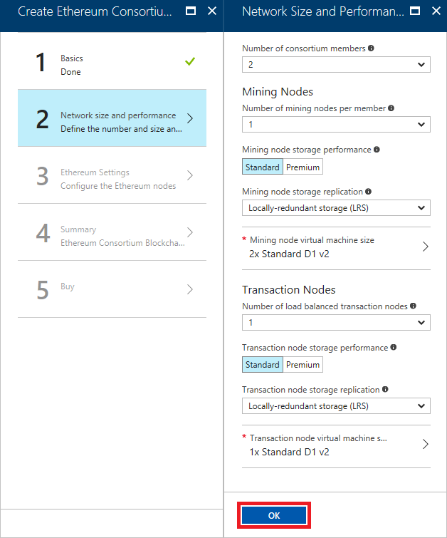
Azure Blockchain-as-a-Service
enables anyone with an Azure subscription to spin up an Ethereum blockchain in minutes.
Users can specify VM sizes / number of VMs to serve as mining and transaction
Very fast forward
https://azure.microsoft.com/en-us/solutions/blockchain/
Notes:
Azure Blockchain as a Service (BaaS) is an easy to deploy solution for creating blockchain networks. Anyone with an Azure Subscription can spin up a modest or monster Ethereum network in minutes using the Azure Portal. Once running, all the tools available for working with Ethereum can be used on the Azure network.

Slide 16
Hands-On Lab
Blockchain on Azure HOL

